Slide 1

GEO Knowledge Hub to preserve and share EO Applications: Introduction and practice
Visão geral sobre análise de dados
GEO Knowledge Hub team
Date: 21th of March from 10:30 to 12:30 (Geneva time)
Where: EIFFEL Project Workshop - Online

Slide 2

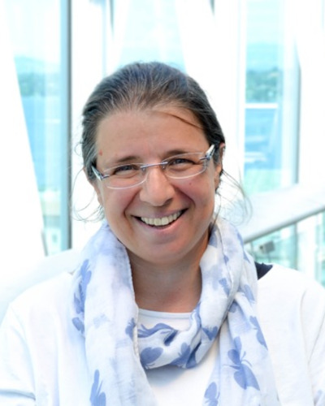

GEO Knowledge Hub team
Kalamkas Yessimkhanova
Paola de Salvo
Felipe Carlos
We are not alone! Our team thanks everyone who worked with us, especially Gilberto Camara, Douglas Cripe, Gilberto Queiroz, Florian Franziskakis, Hendrik Baeyens, and the InvenioRDM community
EIFFEL Project Workshop 2024
GEO Knowledge Hub to preserve and share EO Applications

Slide 3

Material availability
All the materials used during this workshop are available in the following GitHub repository:
geo-knowledge-hub/geo-knowledge-hub-workshop
EIFFEL Project Workshop 2024
GEO Knowledge Hub to preserve and share EO Applications

Slide 4

Group on Earth Observations (GEO)
GEO is a partnership of more than 110 national governments and in excess of 100 Participating Organizations
EIFFEL Project Workshop 2024
GEO Knowledge Hub to preserve and share EO Applications

Slide 5
Group on Earth Observations (GEO)
GEO envisions a future where decisions and actions for the benefit of humankind are informed by coordinated, comprehensive and sustained Earth observations
EIFFEL Project Workshop 2024
GEO Knowledge Hub to preserve and share EO Applications

Slide 6
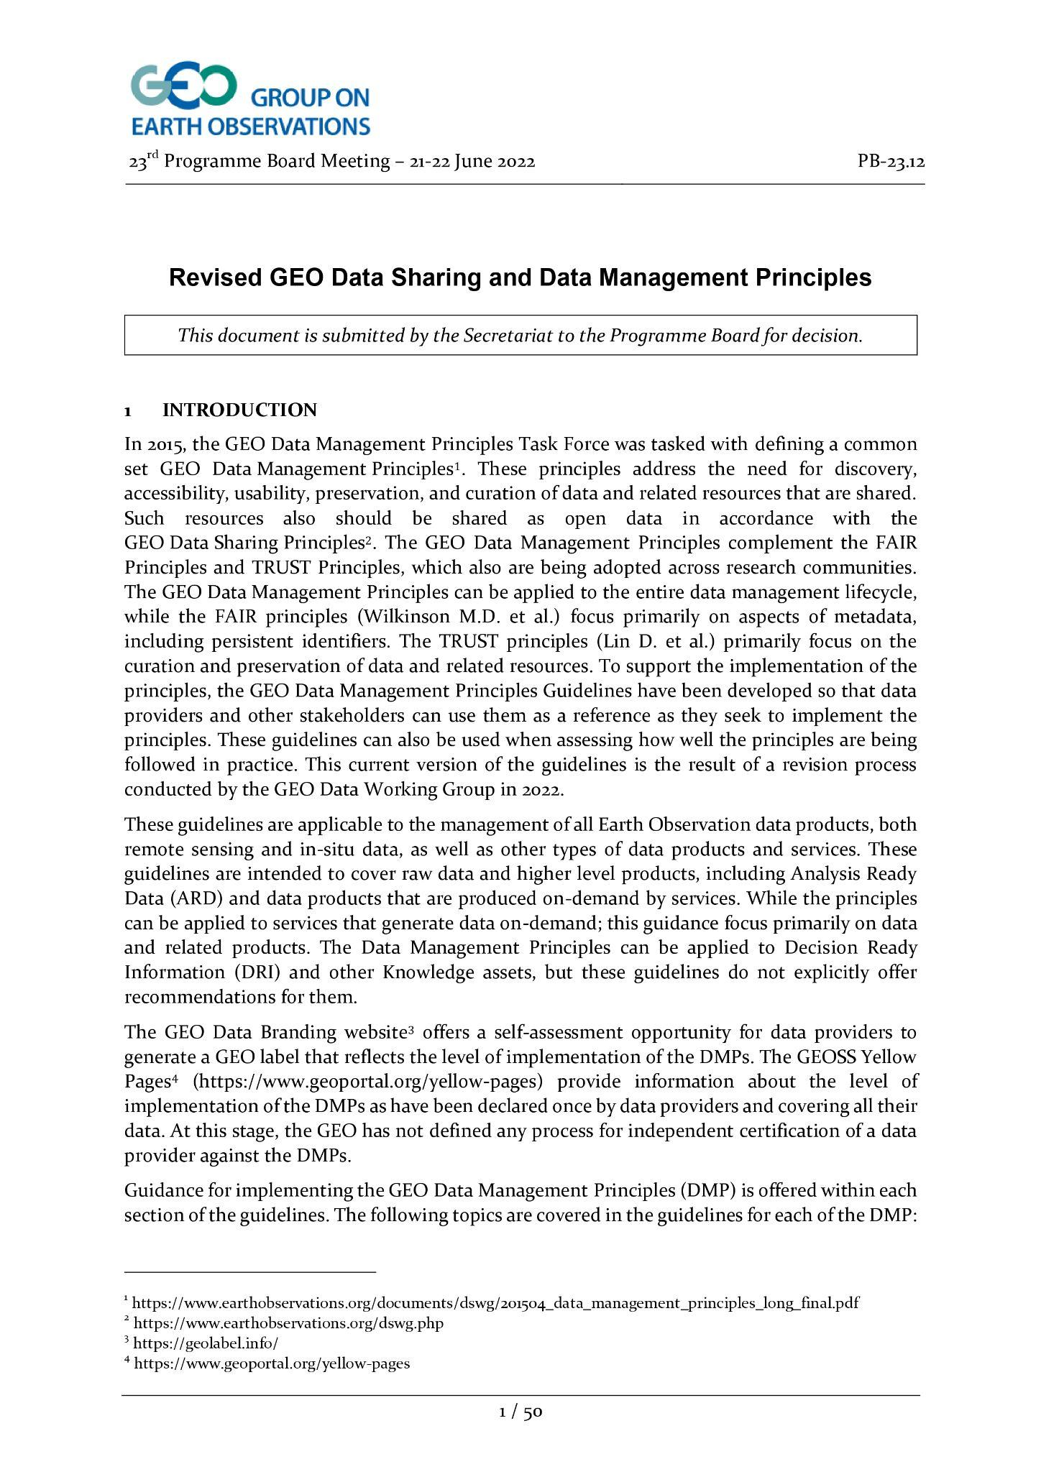
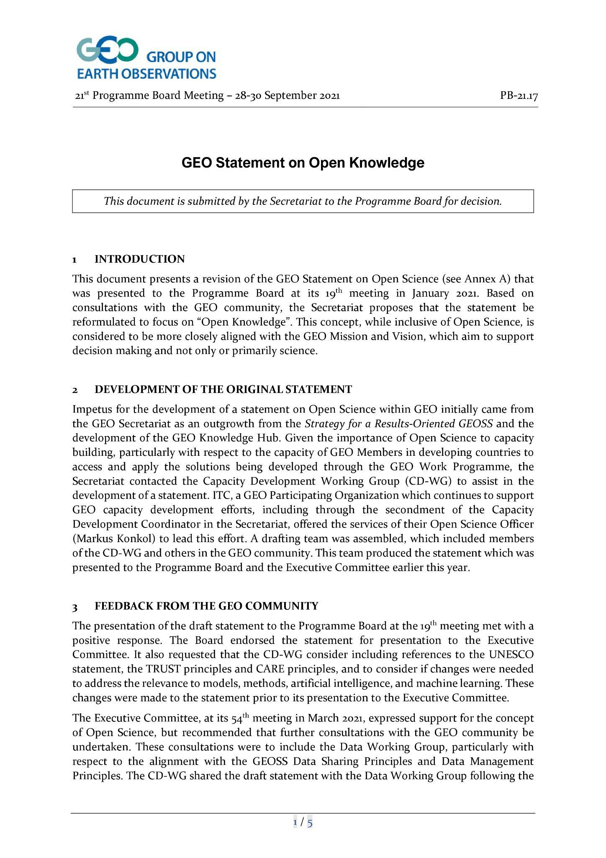
Group on Earth Observations (GEO)
GEO Data Sharing principles
Open Knowledge Statement
EIFFEL Project Workshop 2024
GEO Knowledge Hub to preserve and share EO Applications

Slide 7

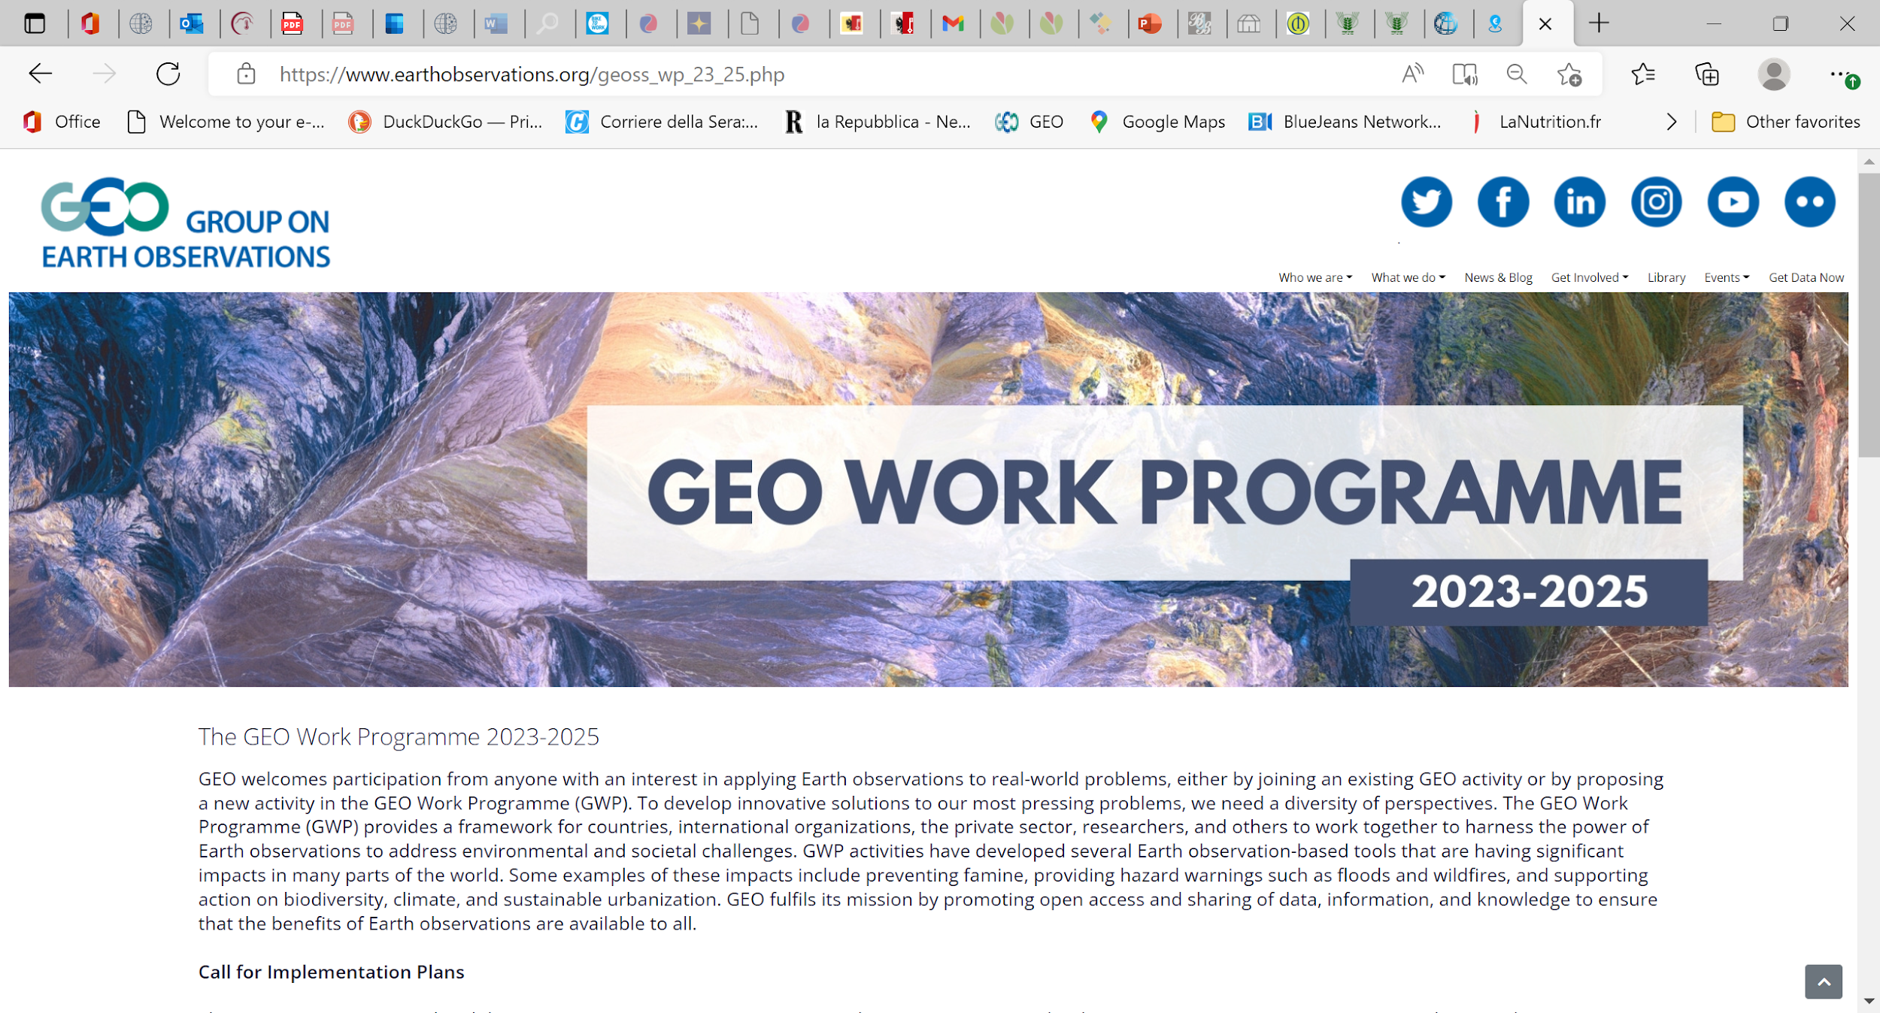
Group on Earth Observations (GEO)
Download the GEO Work Programme 2023-2025 Summary Document, which contains short descriptions of each of the GEO Flagships, Initiatives, Pilot Initiatives and Regional GEOs that comprise the GEO Work Programme.
EIFFEL Project Workshop 2024
GEO Knowledge Hub to preserve and share EO Applications

Slide 8

EIFFEL Project Workshop 2024
GEO Knowledge Hub to preserve and share EO Applications

Slide 9
Best practices for creating Knowledge Packages
EIFFEL Project Workshop 2024
GEO Knowledge Hub to preserve and share EO Applications

Slide 10

Clear Documentation
EIFFEL Project Workshop 2024
GEO Knowledge Hub to preserve and share EO Applications

Slide 11

Descriptive Metadata & Data Accessibility
EIFFEL Project Workshop 2024
GEO Knowledge Hub to preserve and share EO Applications

Slide 12

Make publications visible
EIFFEL Project Workshop 2024
GEO Knowledge Hub to preserve and share EO Applications

Slide 13

Provide access to training materials
EIFFEL Project Workshop 2024
GEO Knowledge Hub to preserve and share EO Applications

Slide 14

Ensure effortless access to the full range of products
EIFFEL Project Workshop 2024
GEO Knowledge Hub to preserve and share EO Applications

Slide 15

Providing User Stories
EIFFEL Project Workshop 2024
GEO Knowledge Hub to preserve and share EO Applications

Slide 16

Licensing
EIFFEL Project Workshop 2024
GEO Knowledge Hub to preserve and share EO Applications

Slide 17

Interact with community
EIFFEL Project Workshop 2024
GEO Knowledge Hub to preserve and share EO Applications

Slide 18

Think in the long-term
EIFFEL Project Workshop 2024
GEO Knowledge Hub to preserve and share EO Applications

Slide 19

Always Up-To-Date
EIFFEL Project Workshop 2024
GEO Knowledge Hub to preserve and share EO Applications

Slide 20
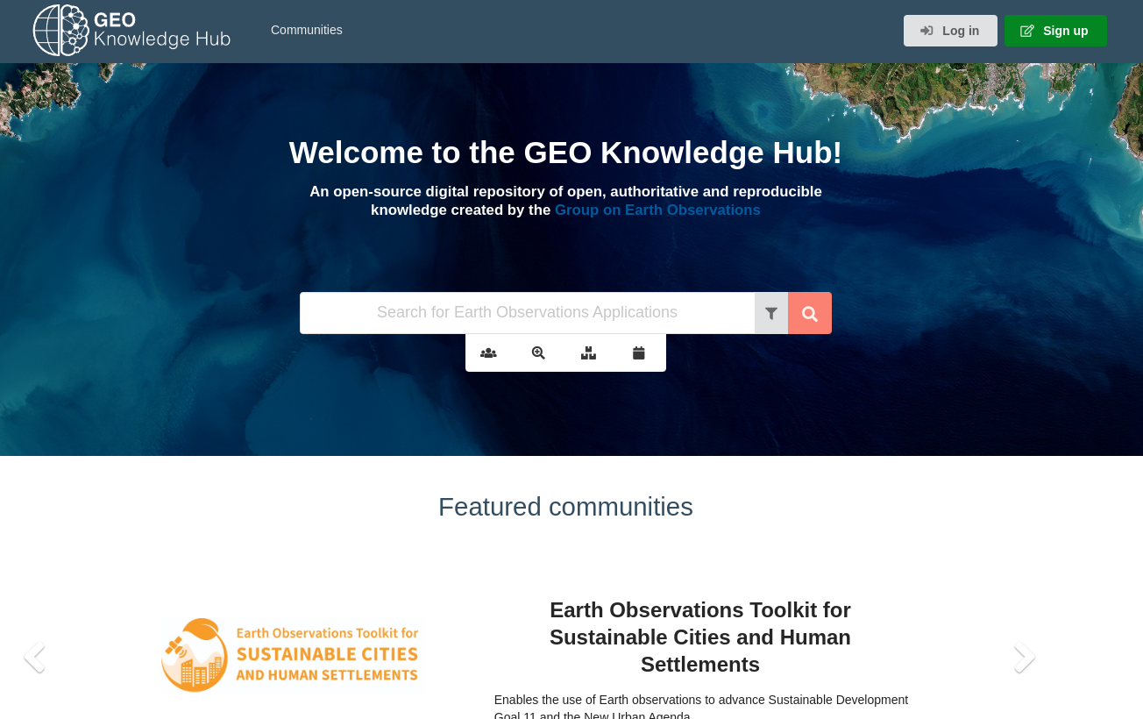
gkhub.earthobservations.org
Practical demonstration
EIFFEL Project Workshop 2024
GEO Knowledge Hub to preserve and share EO Applications

Slide 21
Creating Knowledge Packages
EIFFEL Project Workshop 2024
GEO Knowledge Hub to preserve and share EO Applications

Slide 22

Creating Knowledge Packages

Slide 23

Creating Knowledge Packages

Slide 24
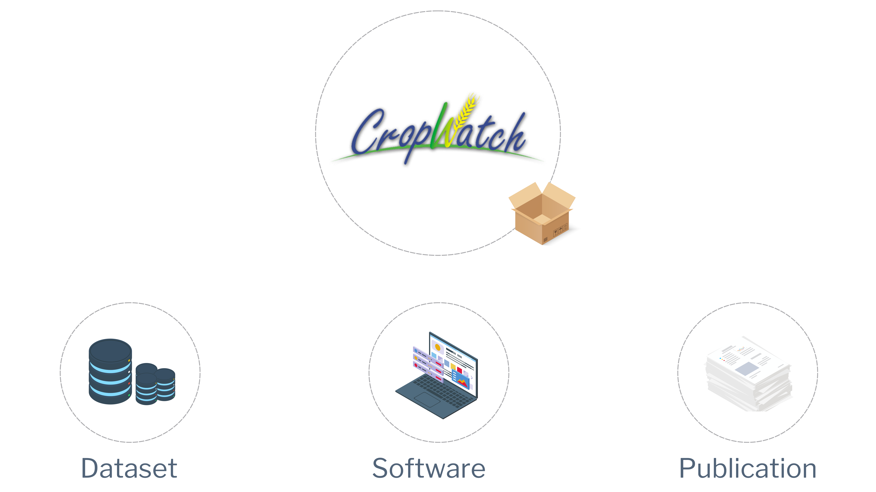
Creating Knowledge Packages

Slide 25
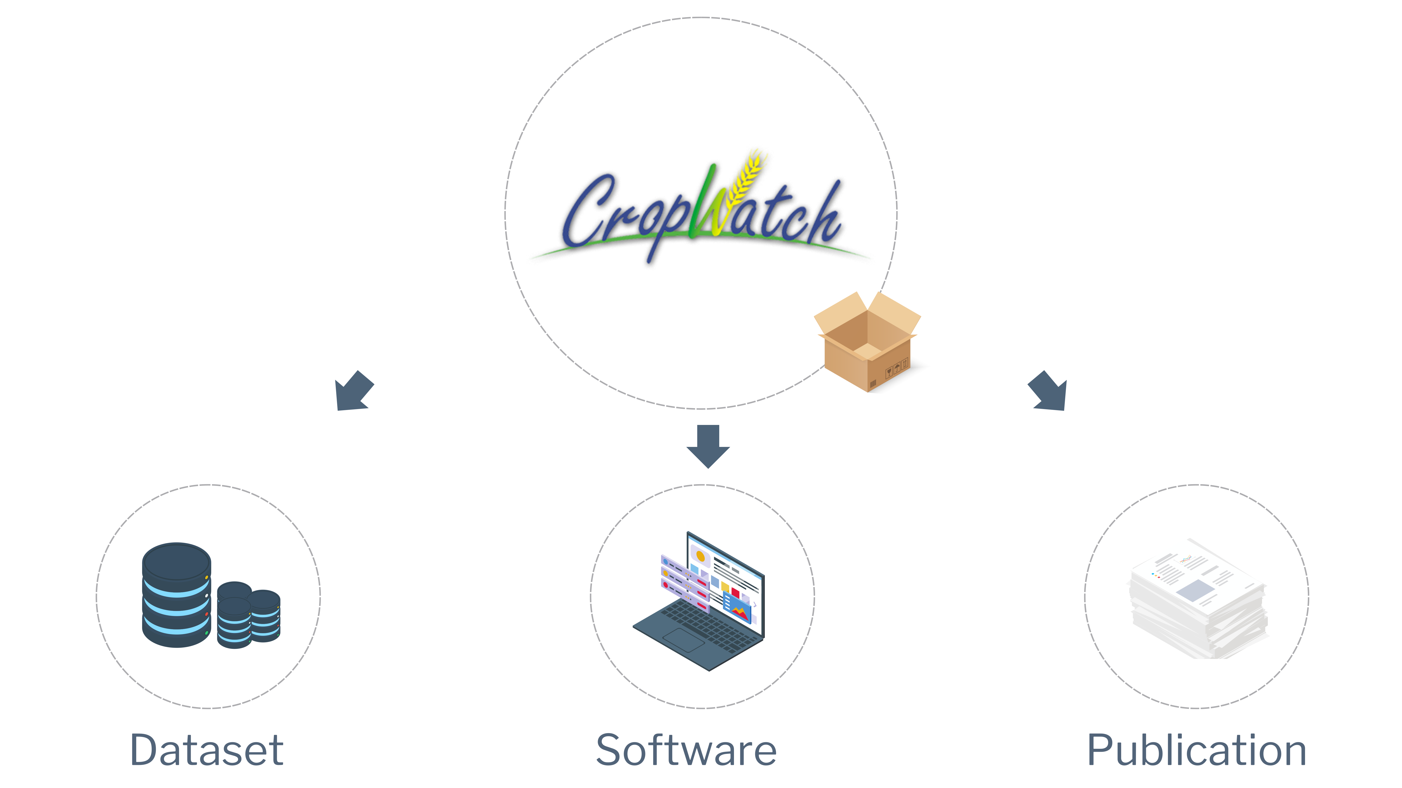
Creating Knowledge Packages

Slide 26
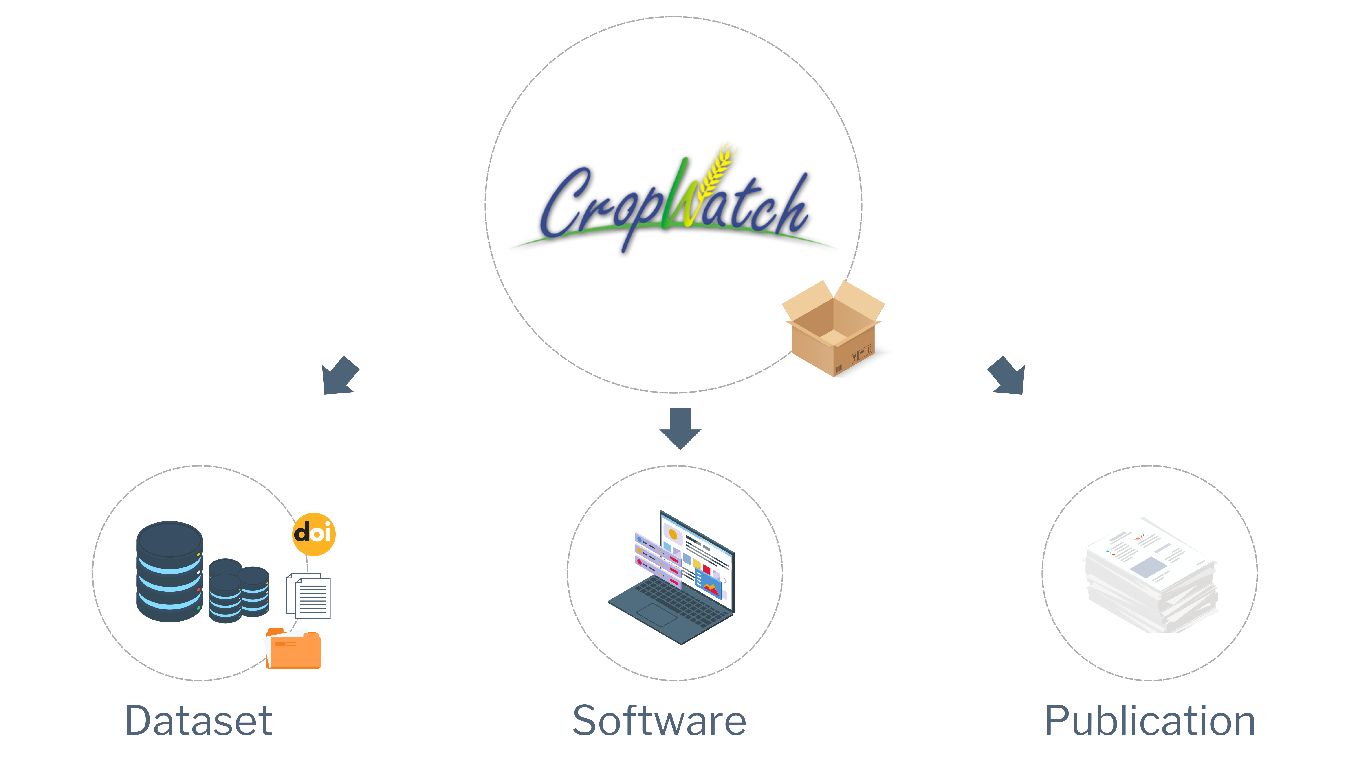
Creating Knowledge Packages

Slide 27
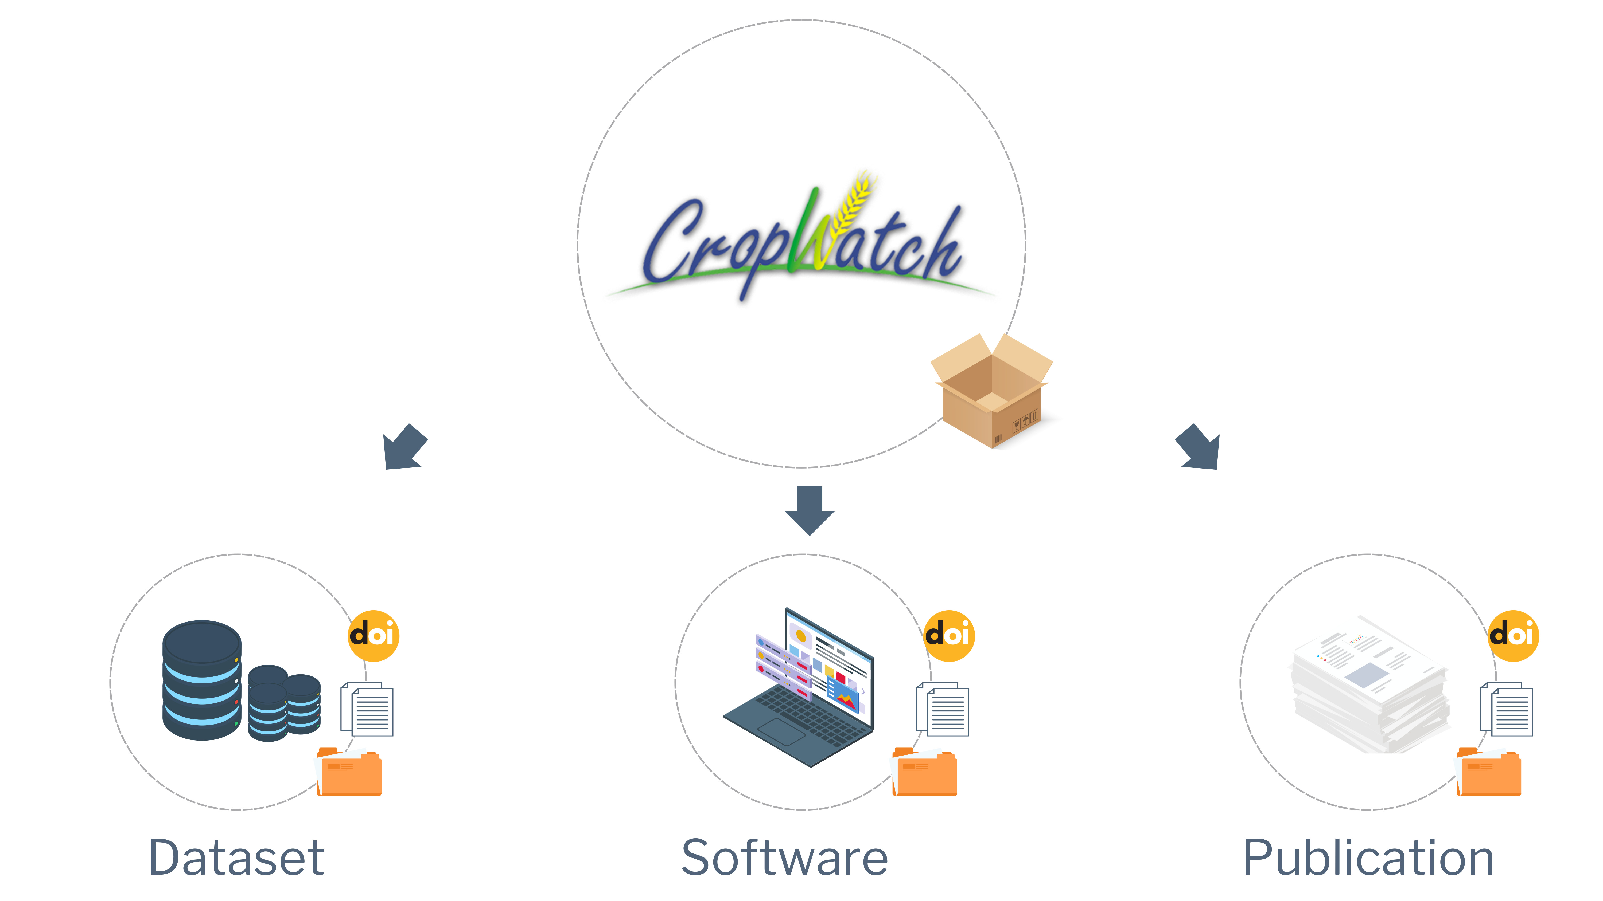
Creating Knowledge Packages

Slide 28
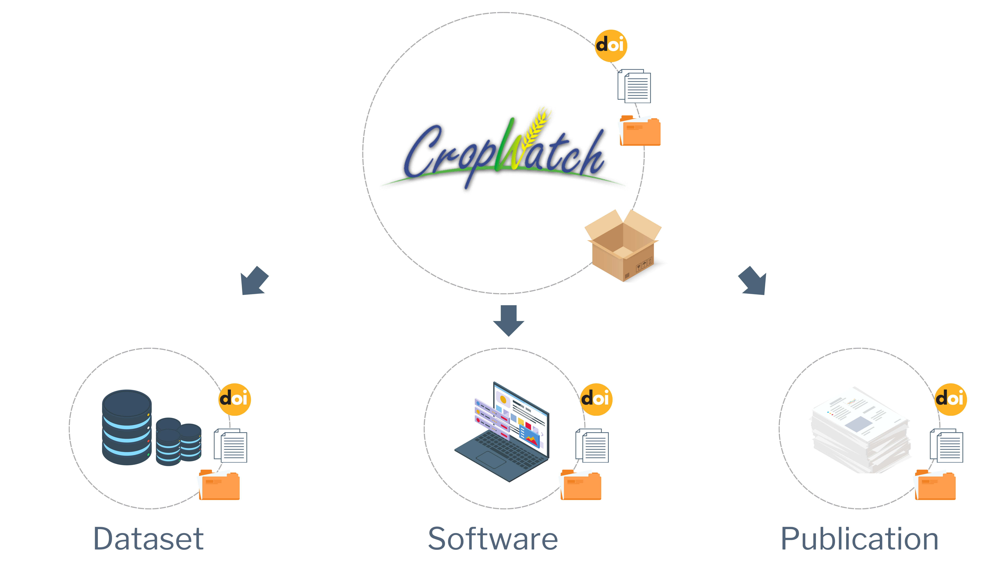
Creating Knowledge Packages

Slide 29
Workshop instance
Practical demonstration
EIFFEL Project Workshop 2024
GEO Knowledge Hub to preserve and share EO Applications

Slide 30
Rest API
EIFFEL Project Workshop 2024
GEO Knowledge Hub to preserve and share EO Applications

Slide 31
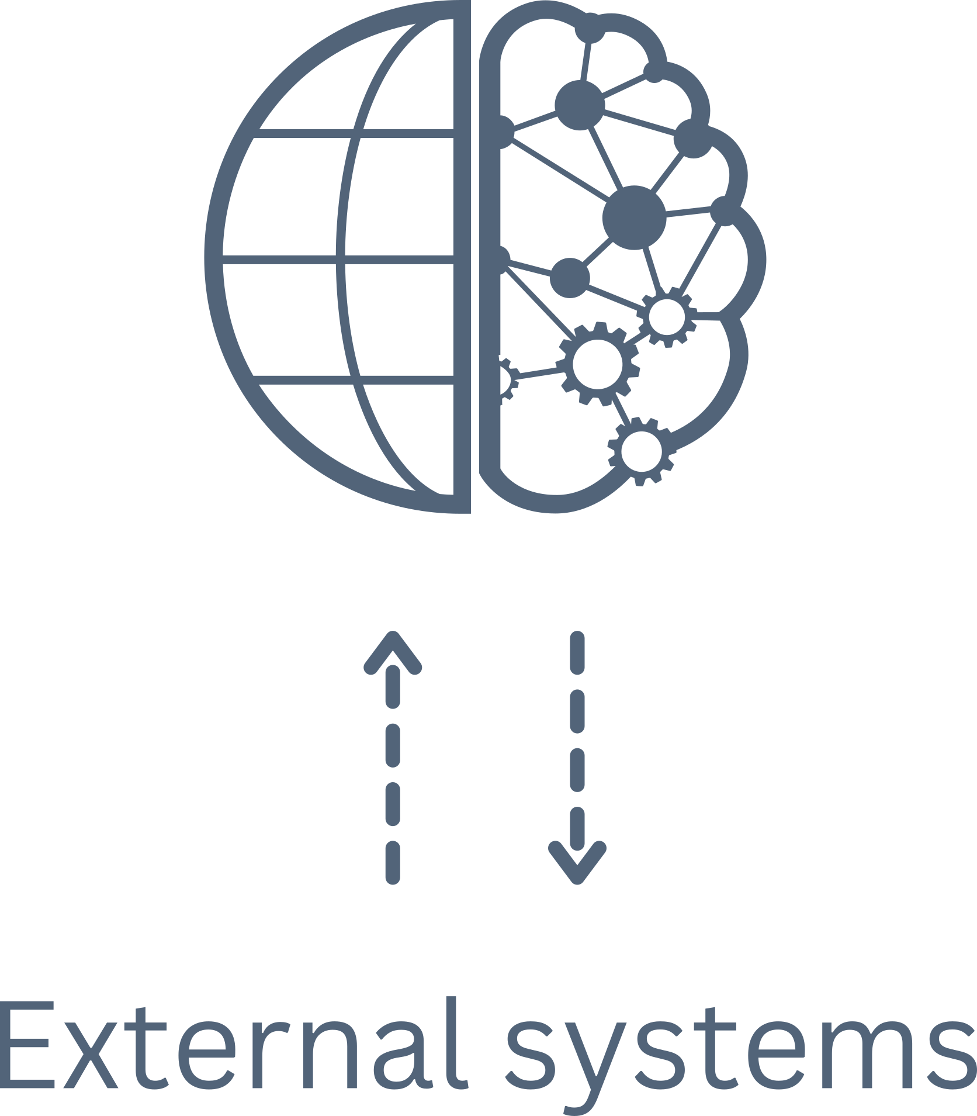
Rest API
EIFFEL Project Workshop 2024
GEO Knowledge Hub to preserve and share EO Applications

Slide 32
Rest API
Bulk Package Loader
EIFFEL Project Workshop 2024
GEO Knowledge Hub to preserve and share EO Applications

Slide 33
Rest API
Bulk Package Loader
OGC/CSW Package Loader
(Harvester)
EIFFEL Project Workshop 2024
GEO Knowledge Hub to preserve and share EO Applications

Slide 34
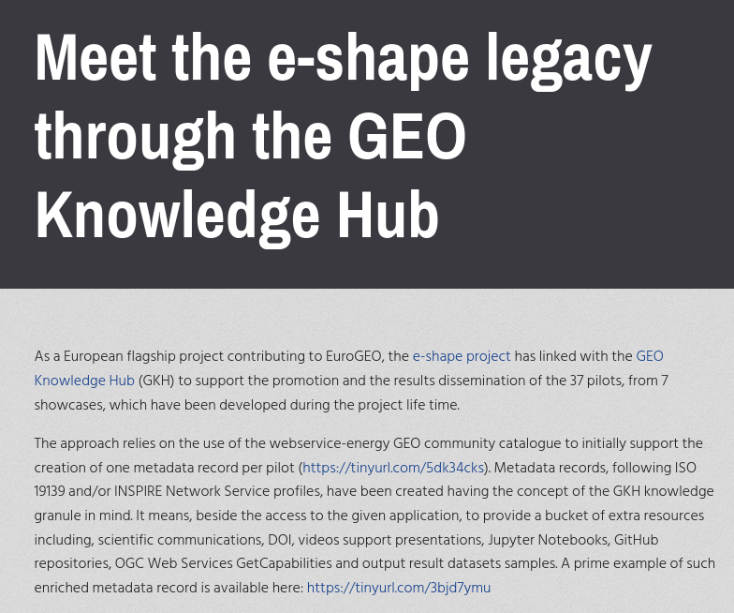
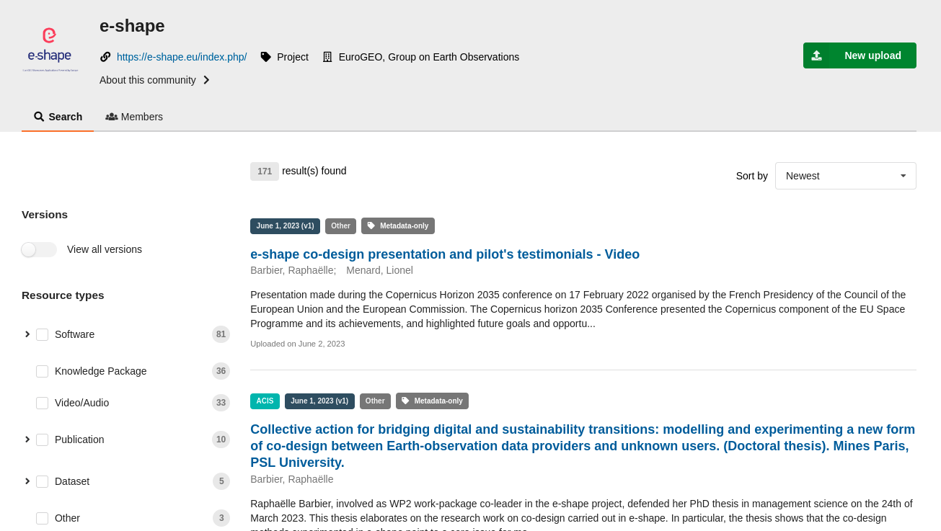
Using the Rest API
tinyurl.com/e-shape-gkh
EIFFEL Project Workshop 2024
gkhub.earthobservations.org/communities/e-shape

Slide 35
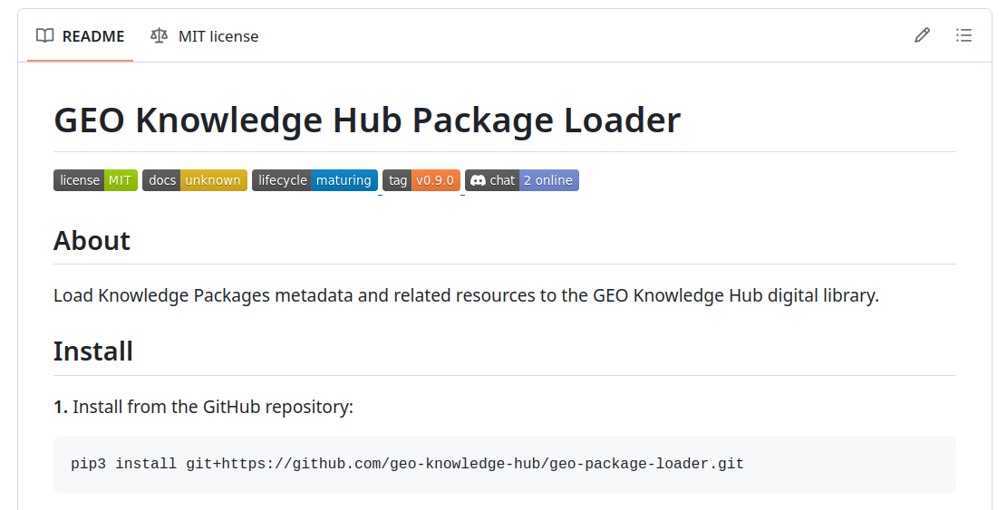
Using the Rest API
github.com/geo-knowledge-hub/geo-package-loader
EIFFEL Project Workshop 2024
GEO Knowledge Hub to preserve and share EO Applications

Slide 36
Documentation
EIFFEL Project Workshop 2024
GEO Knowledge Hub to preserve and share EO Applications

Slide 37
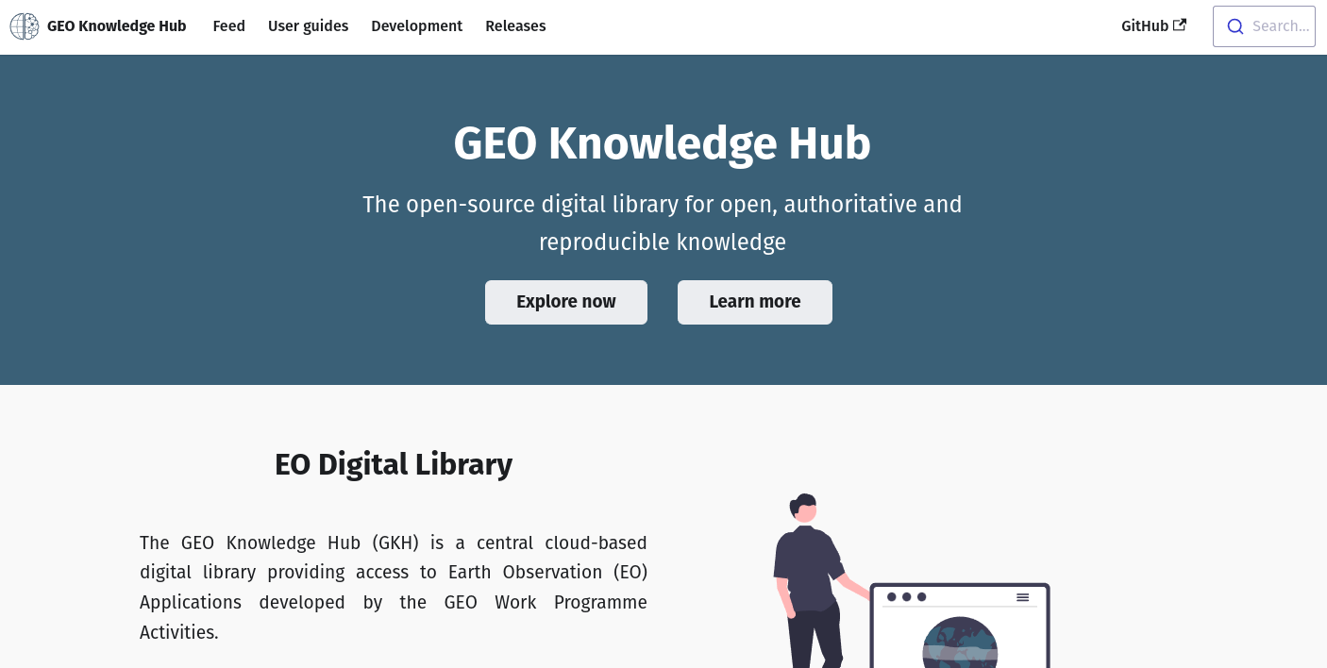
Documentation
gkhub.earthobservations.org/doc
EIFFEL Project Workshop 2024
GEO Knowledge Hub to preserve and share EO Applications

Slide 38
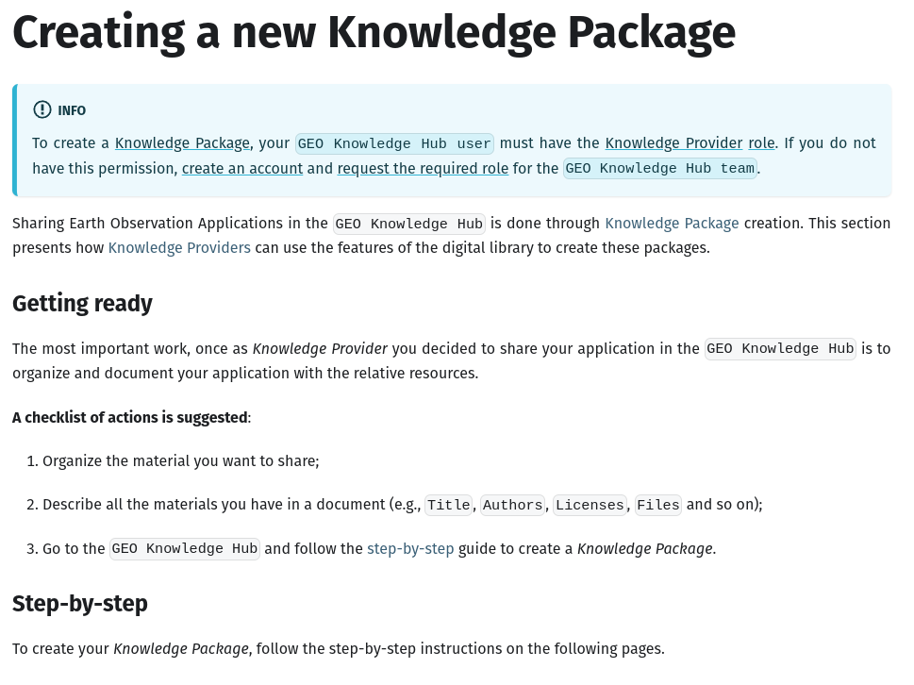
Documentation
gkhub.earthobservations.org/doc
EIFFEL Project Workshop 2024
GEO Knowledge Hub to preserve and share EO Applications

